Slide 1


Unit 2
Frequently asked questions
Notes:
Welcome to Unit 2 of Module 2.
In this unit, we will explore some frequently asked questions about the HHFA.

Slide 2
By the end of this unit, you will be able to:
outline how the HHFA differs from the SARA
explain why the HHFA is called “harmonized”
summarize how facility surveys differ from RHIS/HMIS
describe how service quality is assessed in the HHFA
Notes:
By the end of this unit, you will be able to:
outline how the HHFA differs from the SARA;
explain why the HHFA is called “harmonized”;
summarize how facility surveys differ from RHIS/HMIS; and
describe how service quality is assessed in the HHFA.

Slide 3

How is the HHFA different from the SARA?
Questions
updated
more extensive
address additional service aspects
Resources
more comprehensive set of resources and support tools
Notes:
The HHFA builds on the WHO Service availability and readiness assessment (or SARA), WHO’s previous health facility survey tool.
It uses almost all the original SARA questions, but it has updated them.
The HHFA’s set of questions is much more extensive than SARA’s, and includes additional service aspects.
It also provides a new and much more comprehensive set of resources and tools to support countries in conducting high-quality facility surveys.
Download the reading materials for this unit to get a summary of the differences between the SARA and the HHFA.

Slide 4
Why is the HHFA called “harmonized”?
global service standards
harmonization
global indicator lists
key global facility survey instruments
Notes:
The idea of harmonization refers to the HHFA’s efforts to achieve coherence with global service standards and indicator lists, as well as with other key global facility survey instruments.

Slide 5


Why is the HHFA called “harmonized”?
Global service standards
Notes:
The questions and indicators in the HHFA are based on global service standards, that is, the items assessed for a particular services aspect are those recommended in WHO guidance documents and by subject matter experts.
The HHFA has been developed through inputs from multiple WHO programmes, offices, and partners.

Slide 6

Why is the HHFA called “harmonized”?
Global indicator lists
Notes:
The HHFA also aims to provide data that can contribute to indicators in key global indicator lists, such as the Global PHC indicators.

Slide 7
Why is the HHFA called “harmonized”?
SPA
SDI
Other global facility surveys
Other global facility surveys
A central set of questions and indicators that is common to the key
global surveys.
Notes:
The HHFA was originally developed with the idea of achieving a central set of questions and indicators that is common to the key global facility surveys, so that results can be compared if different surveys are implemented in the same country at different times.
Other global facility surveys include the Service Provision Assessment (or SPA) and the Service Delivery Indicators Survey (or SDI).

Slide 8


How do facility surveys differ from RHIS/HMIS?
≠
Notes:
It is important to understand that the HHFA (and facility surveys in general) are different from the routine health information system, or RHIS.
Let’s look at the main reasons why.

Slide 9
How do facility surveys differ from RHIS/HMIS?
Intervals:
Few years
Collected continuously, reported regularly
HHFA
RHIS
Notes:
The HHFA is usually done at intervals of a few years, while RHIS data are collected continuously and reported regularly, for example, on a monthly basis.

Slide 10
How do facility surveys differ from RHIS/HMIS?
Data collected on:
HHFA
RHIS
Conditions that exist in the facility at a point in time
Patients that use the facilities and their interventions and outcomes
Notes:
The HHFA collects data on different aspects of health services compared with routine data systems.
the main focus of the HHFA is on the conditions that exist in the facility at a point in time, i.e. presence of functional services, resources and systems;
the main focus of the RHIS is on the patients that use the facilities, the interventions they have received, and the outcomes of the interventions.

Slide 11
How do facility surveys differ from RHIS/HMIS?
Data collection:
HHFA
RHIS
External data collectors
Self-reported (staff)
More objective
Less objective
Notes:
HHFA data are collected by external data collectors, which can enable a more objective assessment of conditions in facilities.
In contrast, RHIS data are self-reported, i.e. collected by facility staff themselves. This means they can be less objective.
For example, self-reported data can be distorted due to vested interests of service providers, who may want to transmit a positive image of their health facilities.

Slide 12
How do facility surveys differ from RHIS/HMIS?
Data sourced:
HHFA
RHIS
Representative sample of health facilities
All health facilities
Notes:
HHFAs are usually conducted on a representative sample of health facilities and are not intended to compare individual facilities, while the RHIS should contain data from all facilities and can compare facilities.

Slide 13
How do facility surveys differ from RHIS/HMIS?
HHFA data and RHIS data can complement each other.
Notes:
HHFA data and RHIS data can be used to complement each other, to provide a more comprehensive picture of health facility services.
Download the reading materials for this unit to get a summary of the differences between the HHFA and RHIS/HMIS.

Slide 14

How is service quality assessed in the HHFA?
Notes:
People are sometimes concerned that the HHFA facility audit questionnaires (Service availability, Readiness, and Management and finance) may not contain any questions related to quality of care. This is not true.

Slide 15
How is service quality assessed in the HHFA?
Quality of care is a complex subject with many dimensions.
Notes:
Quality of care is a complex subject with many dimensions, including the availability and functionality of the resources and systems required to implement good quality services.

Slide 16
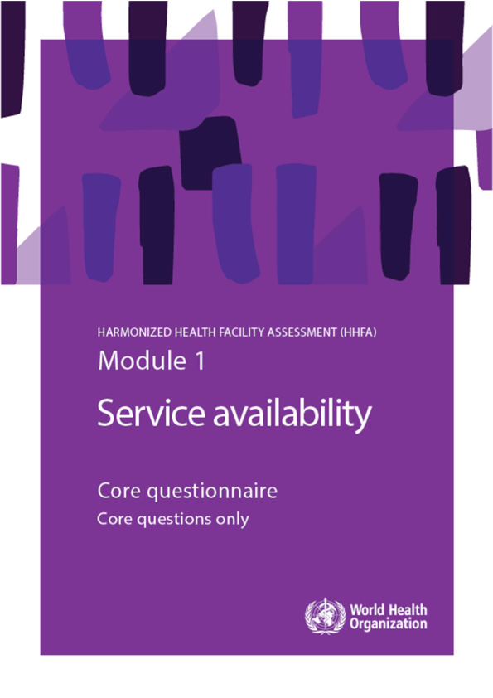



How is service quality assessed in the HHFA?
The facility audit questionnaires:
Are the pre-requisites to provide quality services in place?
Notes:
Questions about these pre-requisites for good quality care form part of the 3 HHFA facility audit questionnaires.

Slide 17
How is service quality assessed in the HHFA?
The record review questionnaire:
Do providers follow the required care processes?
Notes:
In addition, the record review questionnaire of the Quality of care module looks specifically at whether the provider has followed required procedures in the care process.

Slide 18
You have now completed Unit 2.
Now try the end-of-module quiz.
Notes:
You have now completed Unit 2.
Now try the end-of-module quiz.

